Slide 1
Start your own Foreign Exchange Business
Buying and Selling Money!

Slide 2
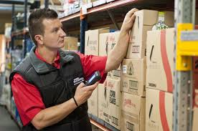
Imagine a business where you have
No Physical Stocks to buy & store
No Business Services
to provide

Slide 3
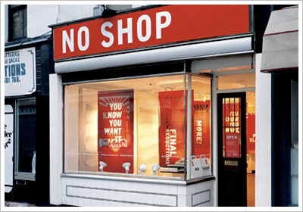
Imagine a business where you have
No Shop to manage and maintain
No Website to keep updated
No Receptionist
No Secretary
No Admin Staff

Slide 4
Imagine a business where you
Don’t need any Customers
Don’t need to Advertise
Don’t need to Market anything
Don’t need any employees
Don’t need to do any Admin Work

Slide 5
A Business that is ALWAYS open
When YOU want to Work!
Imagine a Career where you Never have to
look for a Job Again!

Slide 6
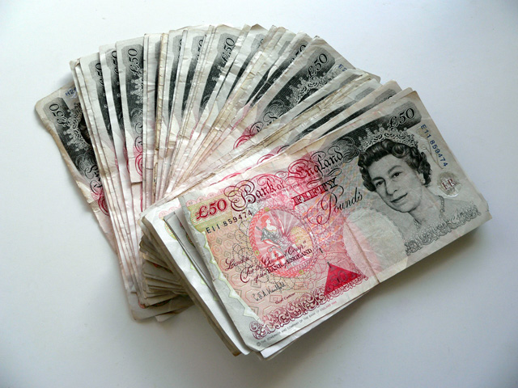
Imagine a business where
You can easily Earn more than
3 times what you are
earning today!!

Slide 7
Foreign Exchange Business
This PERFECT Imaginary business is a REAL
Are you ready to change your life?

Slide 8
Assets You need
What do I need to get started?

Slide 9
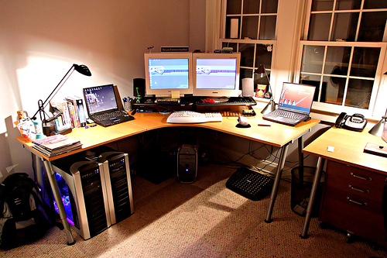
What You Will Need
PC, Laptop or Tablet
Internet Broadband Connection
Home Office

Slide 10
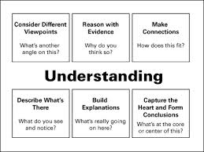
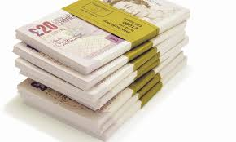
What You Will Need
£500 MINIMUM Capital
£1000 Recommended
£5000 will be ideal
The more you invest, the higher your daily income will be.
Time to LEARN &
PRACTICE.
A SOLID Understanding of HOW the Foreign Exchange Business works

Slide 11
Business Costs
Lets talk about

Slide 12
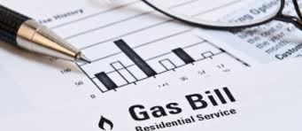
Your Bills
You only have 3 bills
1.
Internet Broadband Costs
2.
Electricity to run the PC
3.
Heating Bills

Slide 13
The Downside
Lets talk about

Slide 14
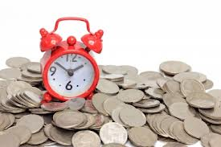
The Downsides are
You WILL Lose MONEY if you make the wrong decisions
You can LOSE your ORIGINAL Capital
You will need to Sacrifice Time & Money - This is a REAL Business & Career
You will be
LONELY
This is not a “Get Rich Quick” business
because you need to understand
what you are doing. This will take time!

Slide 15
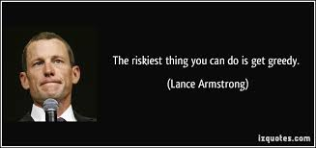
The BIGGEST Downside
GREED
Most people fail because they become TOO Greedy TOO Quick
Stick to your Money Management &
Risk Management Plans!

Slide 16
Show me the money!!
Lets get to the point!

Slide 17
How Much Can I Earn Per Day?
The Market moves at least 50 Points a day
We just want to WIN just 10 Points a day
£1 x 10 = £10
If we Trade £1 per Point, we can earn £10 a day
£10 x 10 = £100
If we Trade £10 per Point, we can earn £100 a day
£100 x 10 = £1000
If we Trade £100 per PIP,
we can earn £1000! a day
Notes:
There are at least a minimum of TWO opportunities a day to earn 10 PIPS throughout an average day ( so potentially you can earn £2000 per day!)

Slide 18
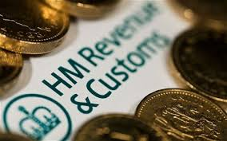
Keeping The Best For Last!
ALL YOUR EARNINGS ARE
TAX FREE
(ONLY in the UK and Eire)
Notes:
Are you ready to change your life?
Never look for work again
Never get sacked or made redundant
Never worry about interviews anymore
Never rely on anybody else for your earnings

Slide 19
Show me how to EARN the MOney
Show me how easy is it to make money!

Slide 20
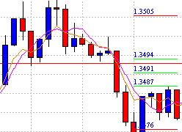
How to Trade & Make Money
Let me show you how easy it is to make money!
Trade using Historic Price Lines.
Trade using Candlesticks.
Trade using
Indicator.

Slide 21
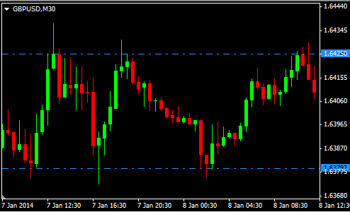
Lets earn £100 per day using Price Lines
We are going to use
Historic Price Lines to
place a BUY trade
Find a Historic Price Line
Wait for the Prices to Drop to the Price Line & BUY
Invest £10 per Point
Ride it for only 10 Points
£10 x 10 = £100 in ONE Day!!!
We could have made £450 (£10 x 45) if we did not exit
Historic Price Lines
Prices
Move
45 Points
Prices do not Break through the Historic Price Line
Buy Here

Slide 22
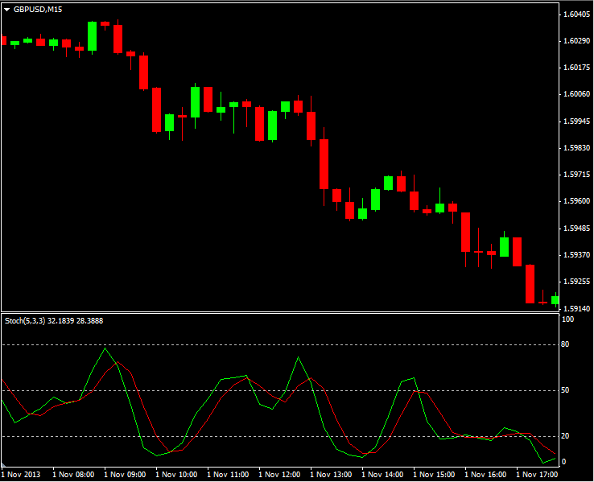
Lets earn £300 per day using an Indicator
We are going to use an Indicator Called Stochastic
Sell when the Green Line Crosses Red Line
Exit on Crossover again
Market moves 30 Points
£10 x 30 Points = £300
In this example, you could have earned £600 in a day (£300 TWICE!!)
Enter
Enter
Exit
Exit
Enter
Enter
Exit
Exit

Slide 23
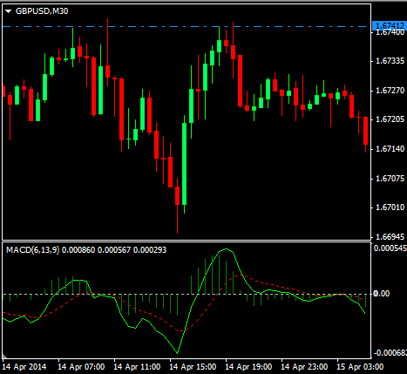
Lets earn £400 per day using an Indicator
Exit
We are going to use an Indicator Called MACD
Notice that the prices are NOT breaking the Historic Price Line
Enter when the Green Line Crosses Red Line
Exit on Historic Price Line
Market moves 40 Points
£10 x 40 Points = £400
Historic Price Line
Prices Moved 40 Points
£10 x 40 = £400
Enter
Enter

Slide 24
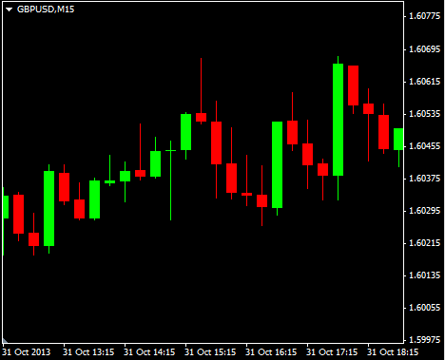
Lets earn £1000 per day!
For this, we will need to find a Reliable Pattern!
Find a PIN Setup
Invest £100 per Point
Ride it for only 10 Points
Exit and Reap the Reward!
£100 x 10 = £1000 in ONE Day!!!
Lets see another Pin Setup
Pin Setup
Exit after 10 Points
£100 x 10 Points = £1000!
Prices Move more than 20 Points

Slide 25
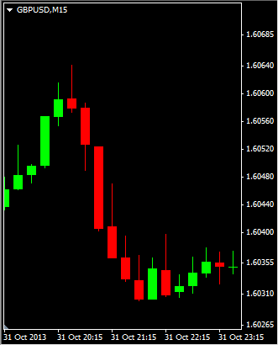
Another Pin Setup Trade
Look for the reliable PIN
Enter at bottom of PIN
Exit on Green Candlestick
Market moves 20 Points
£100 x 20 Points = £2000!! in 1 day.
Enter
Here
PIN Setup
Market
moves
20 points
Exit
Here
Do you need
anymore convincing?

Slide 26
Do You Want this Opportunity?
Now I Ask You

Slide 27
What YOU need to do now
Step 1:
Get TRAINED and EDUCATED
Start one of our Training Courses.
Step 2:
Get EXPERIENCED – Practice makes Perfect
We will set you up with Demo Account
& a Live Account

Slide 28
Training Courses

Slide 29
Training Courses for Beginners
Course 1:
Fundamentals of Foreign Exchange Business
Course 2:
Trading Foreign Exchange Successfully

Slide 30
How Much is the Training?
Each course costs £999 individually
Book Courses 1 & 2 for £1700
Save £300
Only for today:
Book both Course today for £1500
Save £500

Slide 31
It’s time for you to hatch your Money Egg
What are you waiting for?

Slide 32
Book Your Courses NOW!
Book your courses today & Start training Tomorrow!
Go to www.MoneyBusiness.co
Or Pay Direct Now
Account Name: ilm Group
Account No. 43141279
Sort Code: 09 06 66

